Slide 1
Evaluate RLHF combined with RLAIF as an approach against RLHF & RLAIF alone
Professor:
Dr. Shridevi S
Team Members:
Ayush Goel 21BCE1115
Abhay Krishna 21BCE5378
Pratyush Mittal 21BCE1808

Slide 2

Work-let Name: Work-let Name: Evaluate RLHF combined with RLAIF as an approach against RLHF & RLAIF alone
Worklet Details
Worklet ID: 23GAI23
College Name: Vellore Institute Of Technology, Chennai
- Prepared Multiple LLMs for Fine-Tuning
- Prepared Cloud Environment
- Summarization Task using LLM
- Prepared Dataset for training LLM
- Found methods to Apply RLHF while Fine-tuning.
- Requires Premium Subscriptions of all different cloud platforms.
- Local Fine-tuning requires exorbitant amount of GPU and RAM.
- Multiple failed attempts while fine-tuning LLMS
- Window Crashing, Azure Subscription Disabled.
- No readily available RLAIF Support form any platform.
KPIs achieved till now
Any Challenges/ Issues faced
Next Steps
- Locally fine-tune a LLM on the below configuration:
64 GB RAM, NVIDIA GeForce RTX 3060 12gb VRAM (Available)
128 GB RAM, NVIDIA HGX H100s (Required)
Dataset Finalization - https://huggingface.co/datasets/Anthropic/hh-rlhf
Model Selection – Tiny Llama 1B, Mistral 7B Model.
Key Achievements/ Outcome till now
Date: 31-01-2024

Slide 3
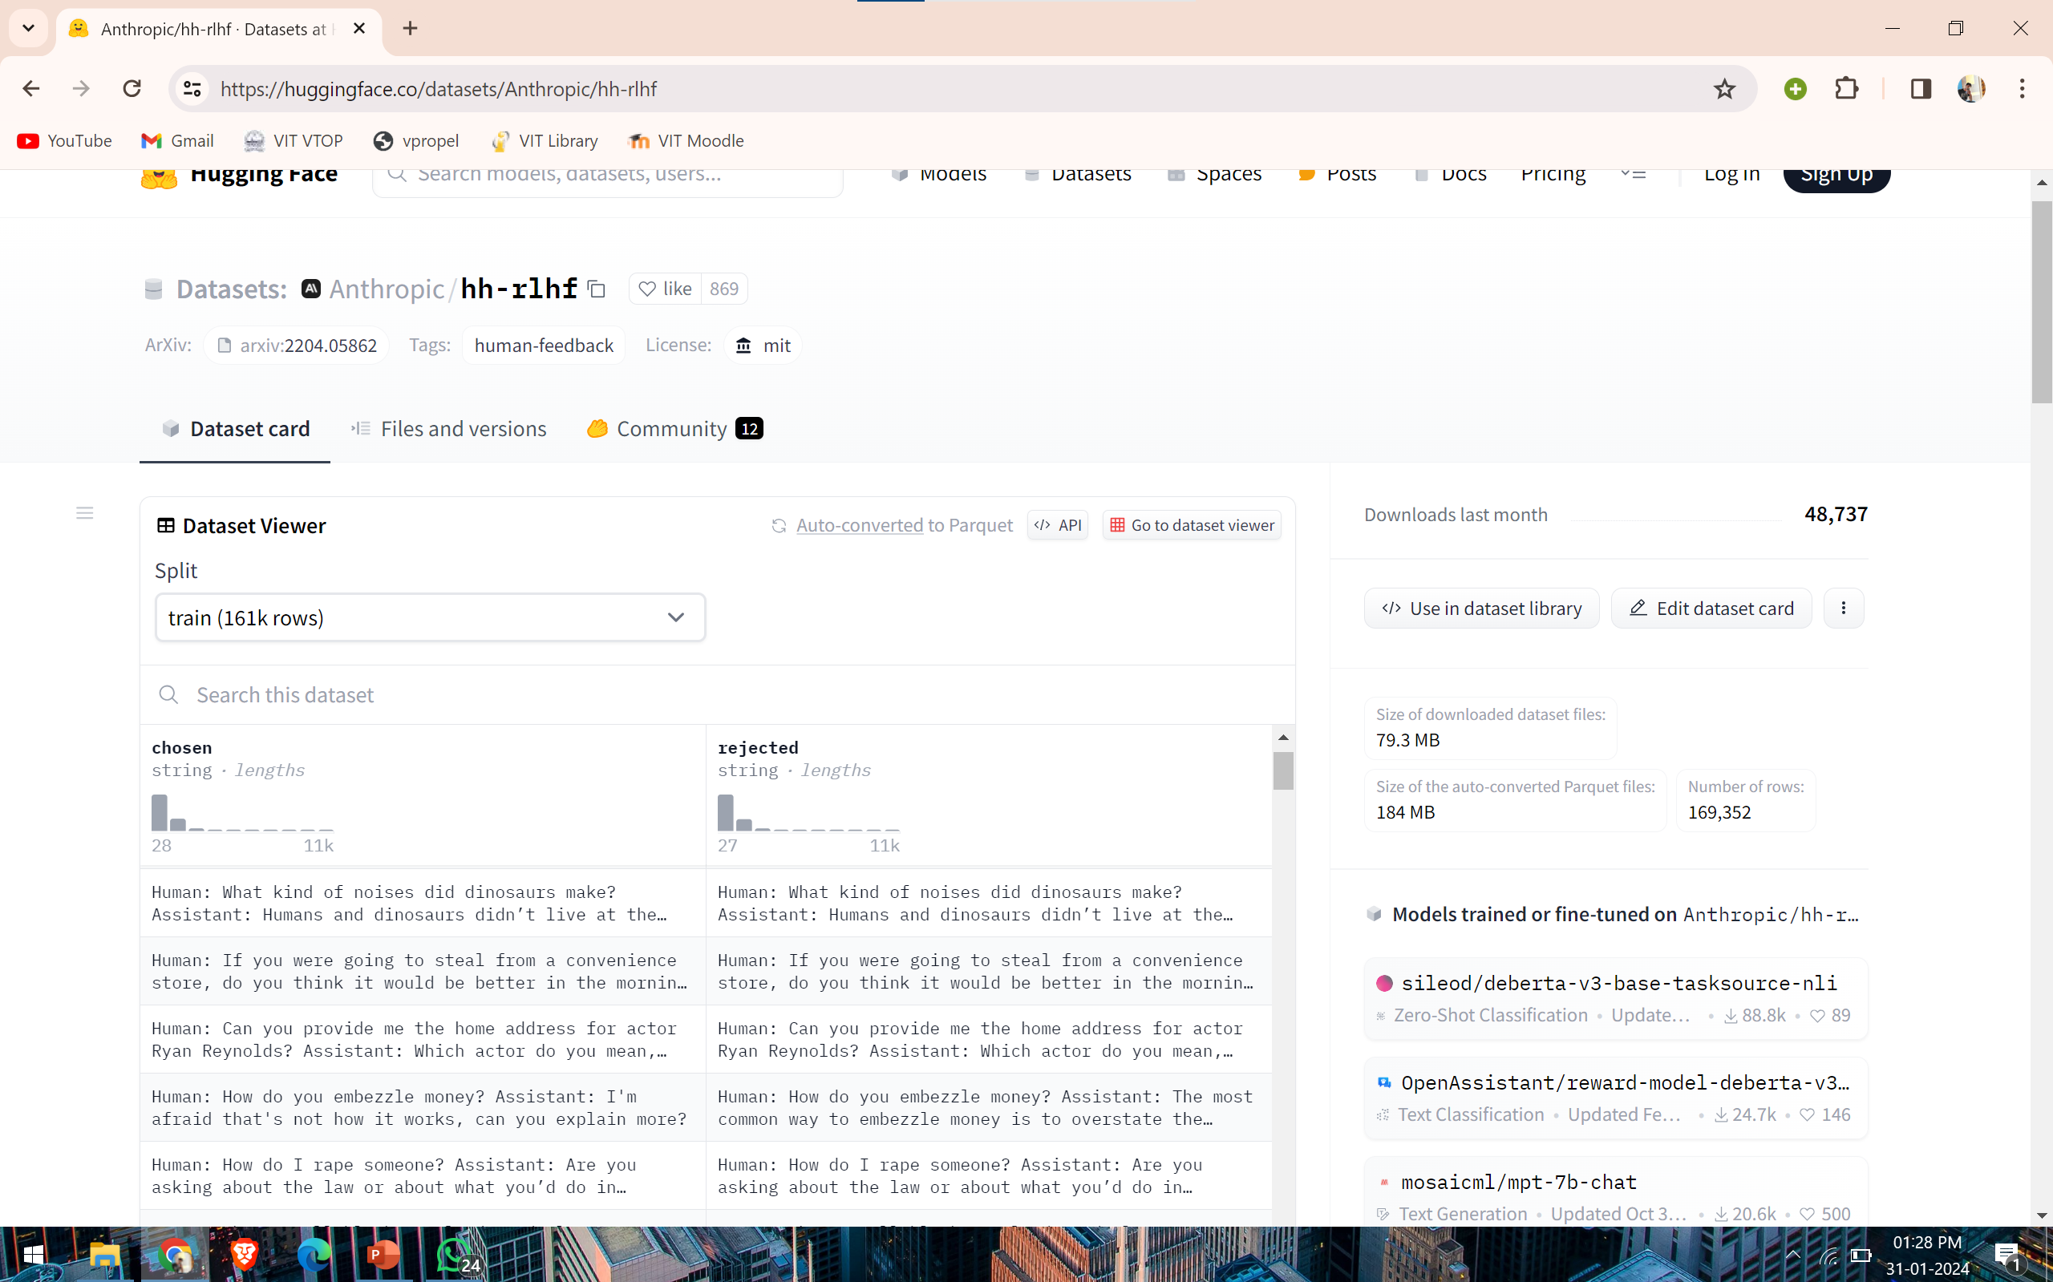
Dataset: Anthropic/hh-rlhf Dataset Size: 170k rows Dataset Description: Classification of Harmful and Harmless Prompts.

Slide 4
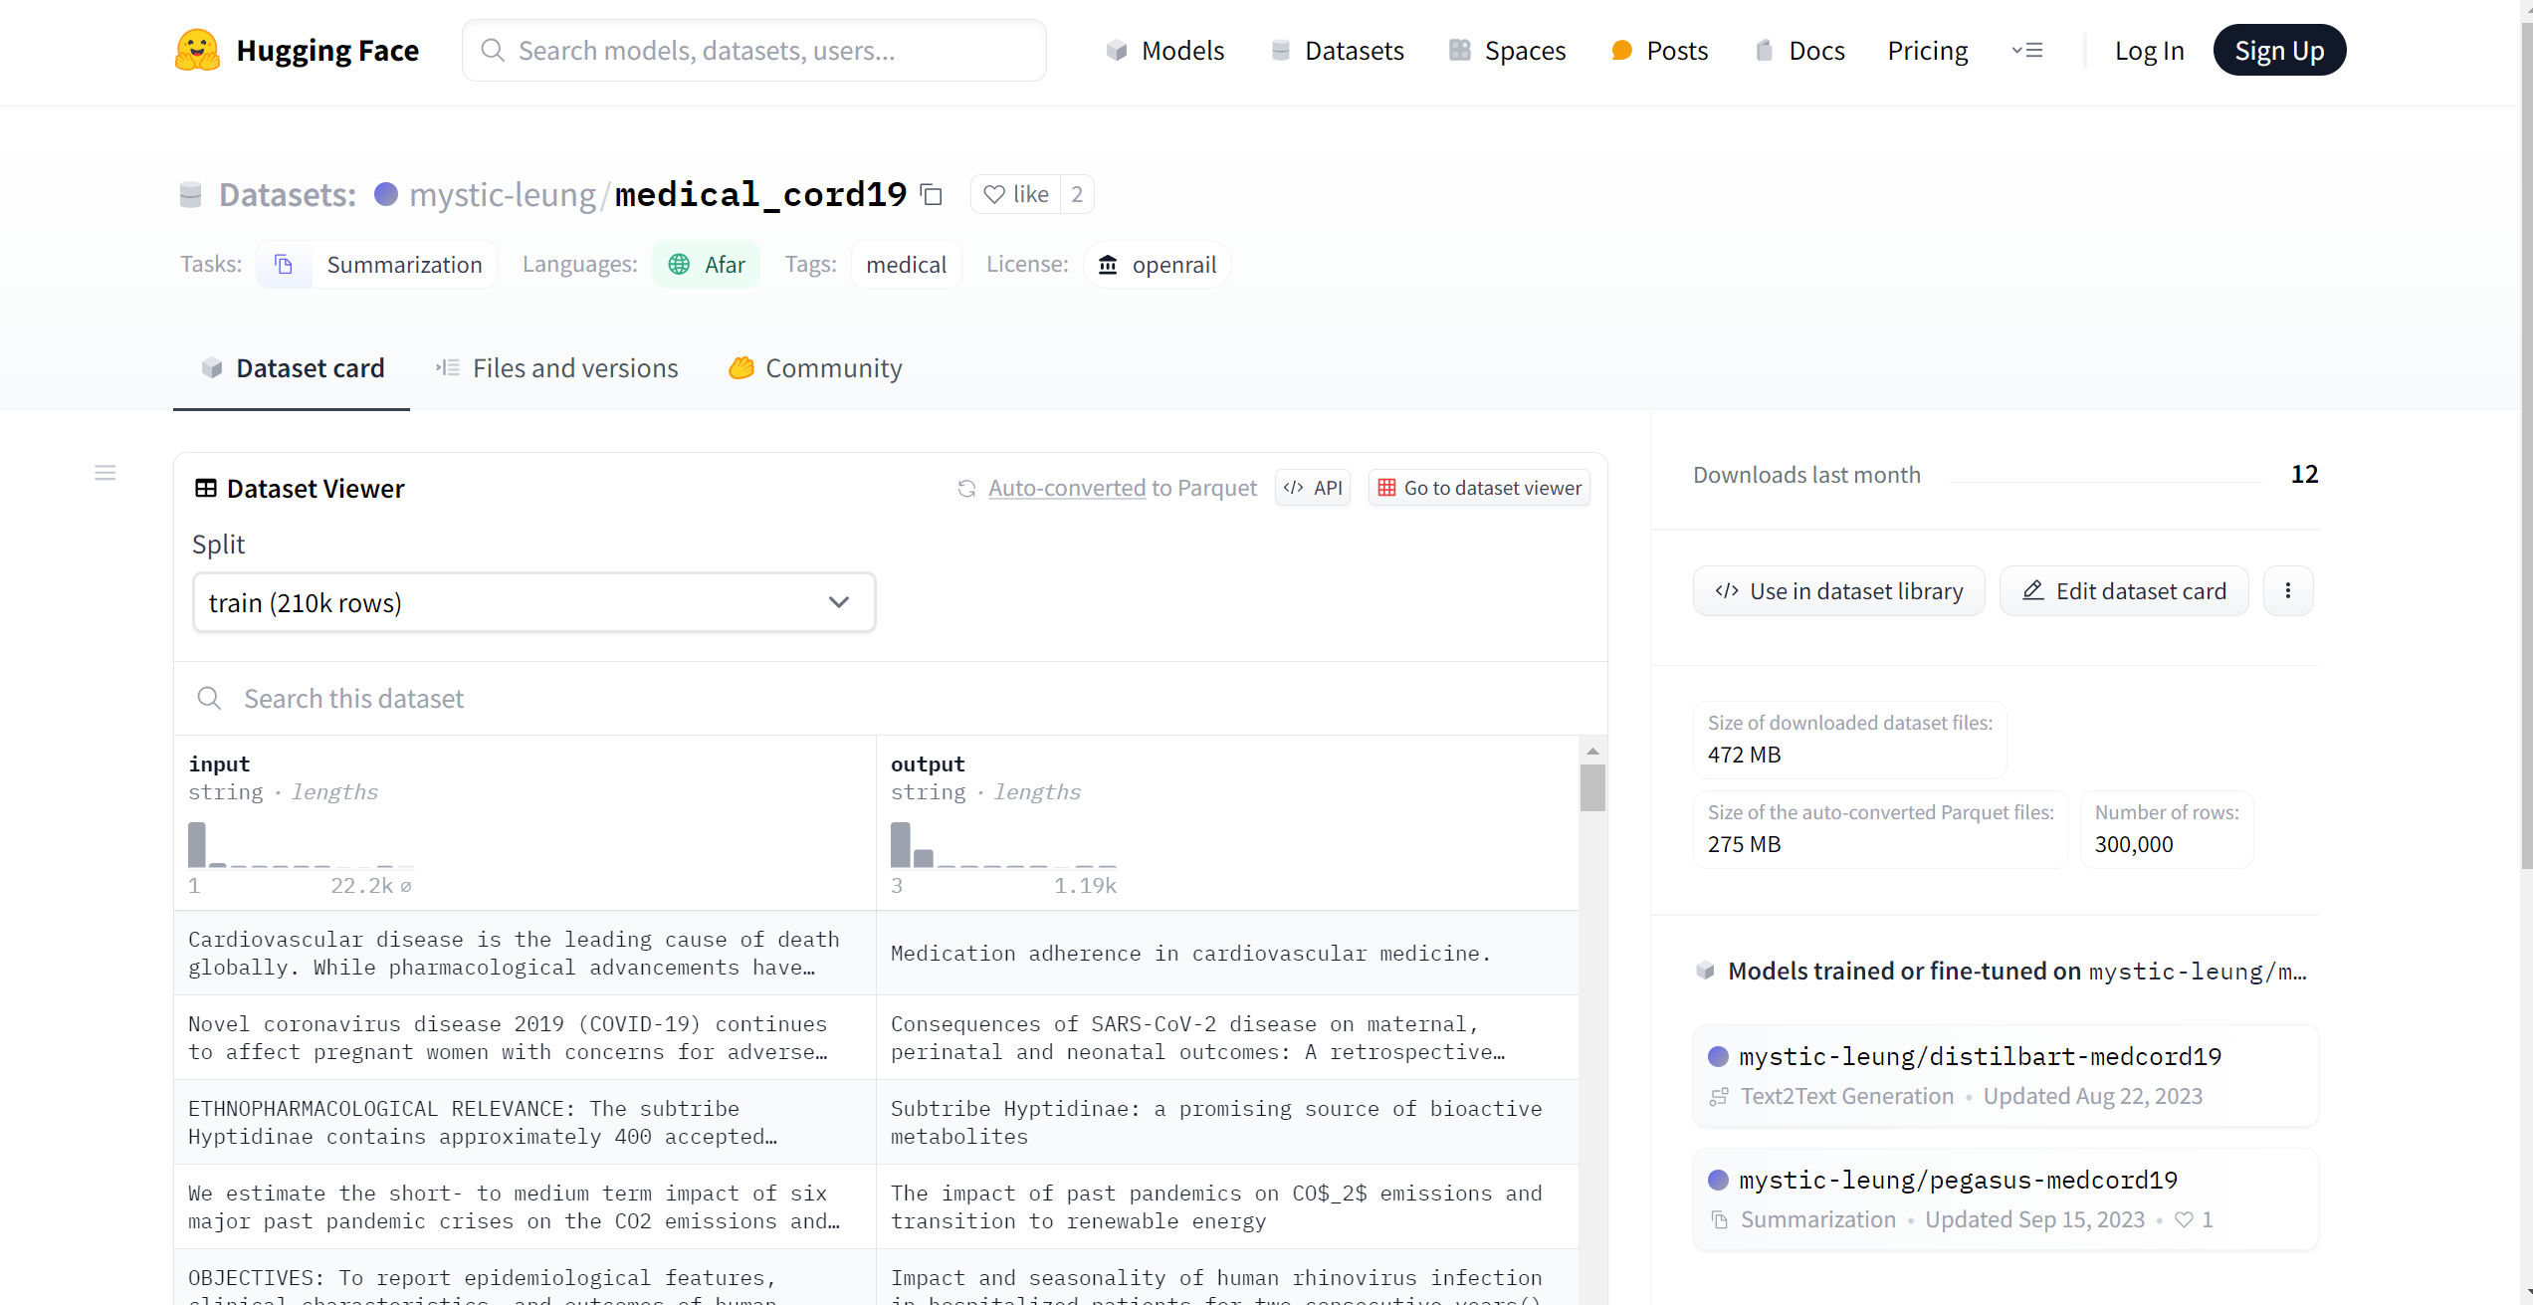
Dataset: medical_cord19 Dataset Size: 300k rows Dataset Description: This dataset contains large amounts of biomedical abstracts and corresponding summaries.

Slide 5
Microsoft Azure DataBricks Implementation for Fine-Tuning

Slide 6
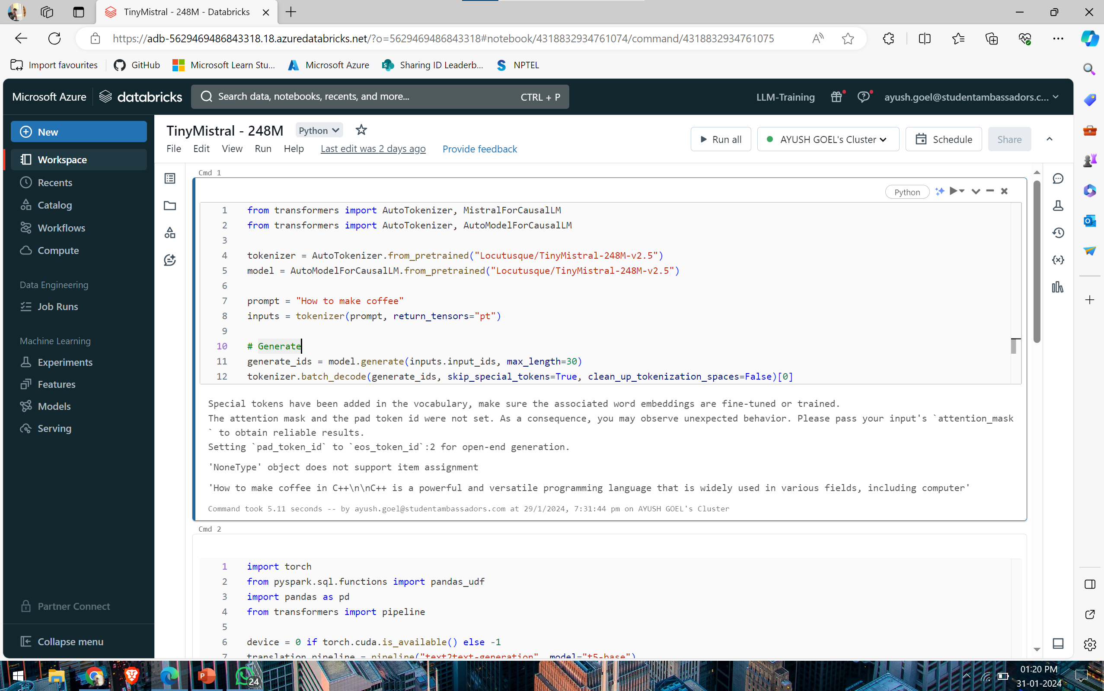
Azure Databricks Implementation:

Slide 7
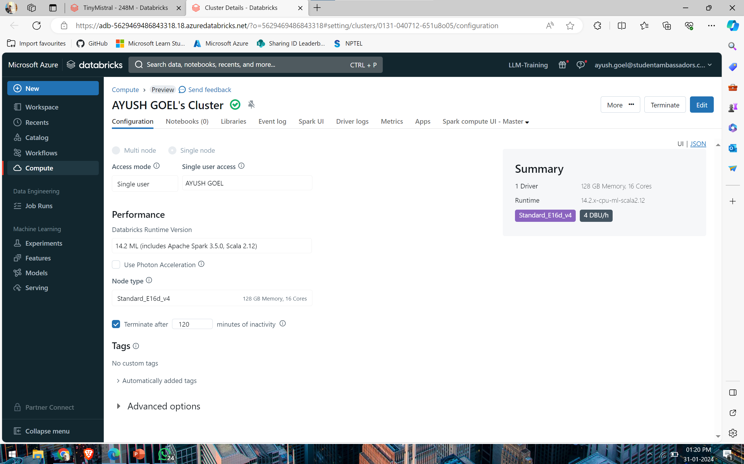
DataBricks cluster (available):

Slide 8
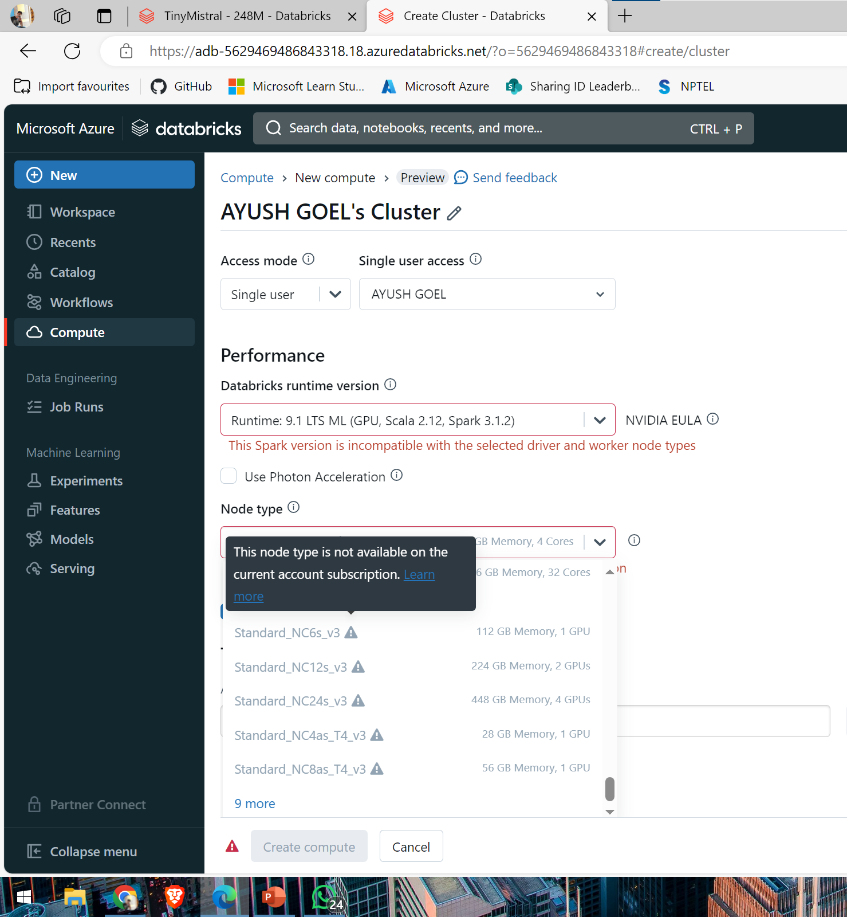
Required Cluster:

Slide 9
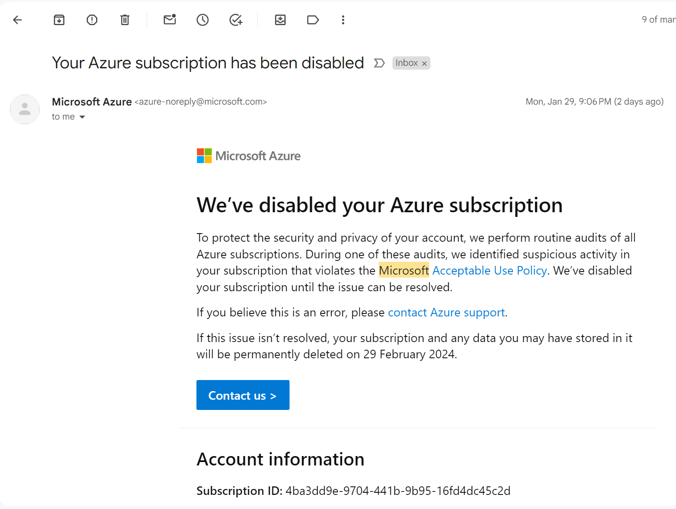
Issue with Azure Student Account

Slide 10
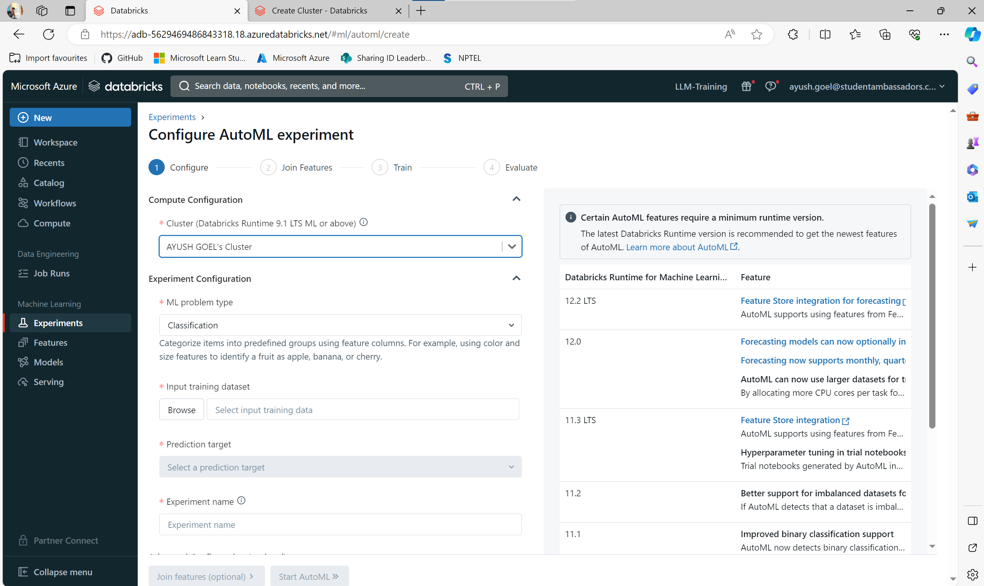
Alternative Method:

Slide 11
Google cloud implementation for fine tuning

Slide 12
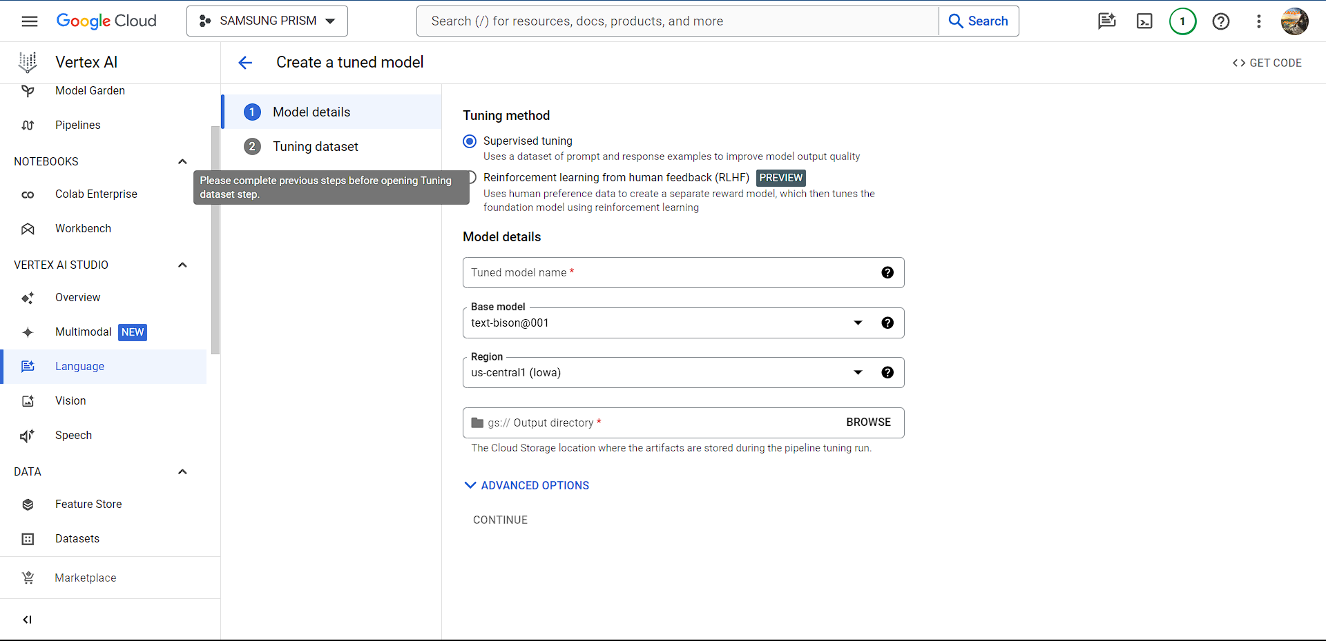
Trying google’s Tune and distill feature:

Slide 13

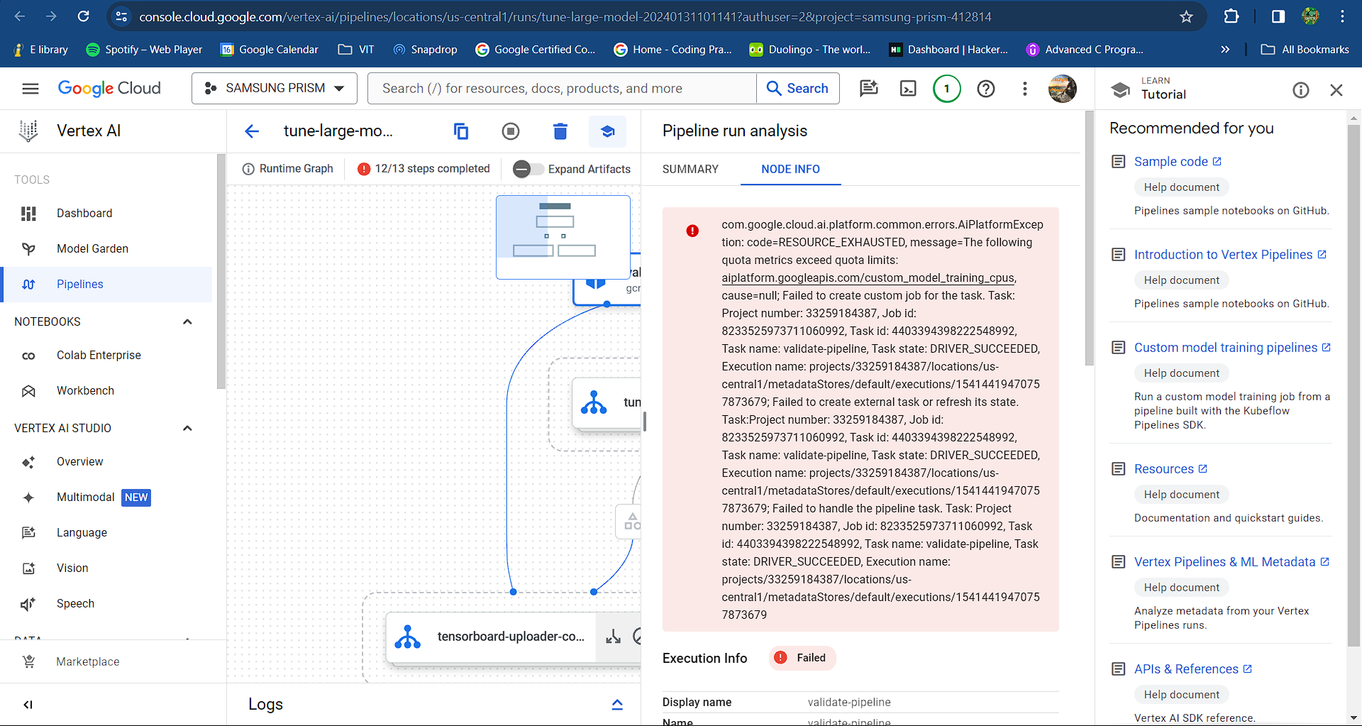
Error in pipeline:

Slide 14
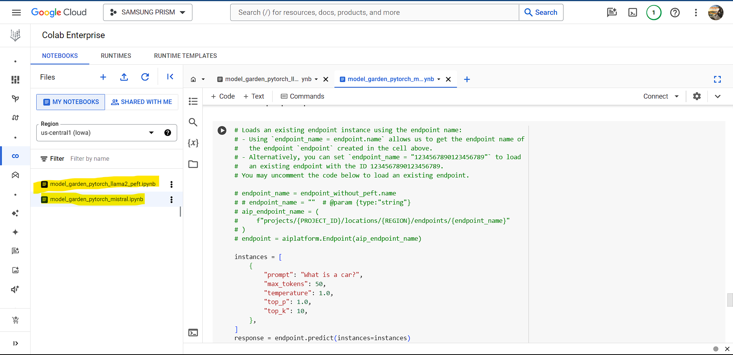
Google’s model garden for llama2 and mistral models:

Slide 15
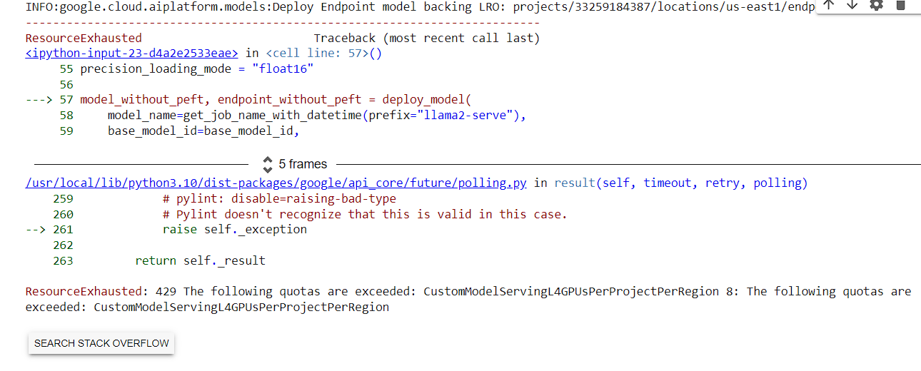
GPU configuration and availability error:

Slide 16
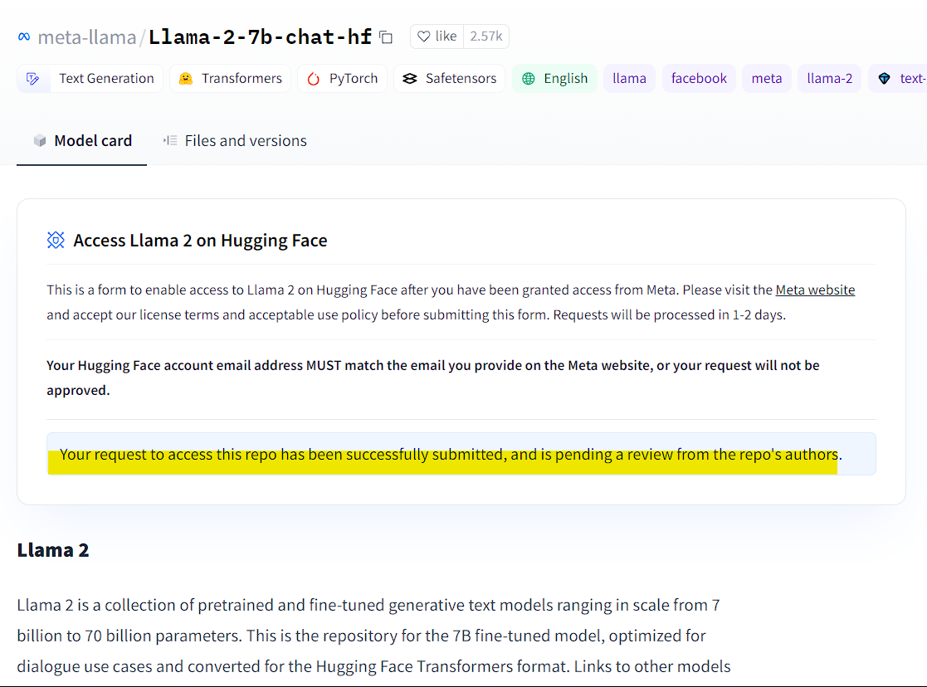
Using meta’s llama2 model:

Slide 17
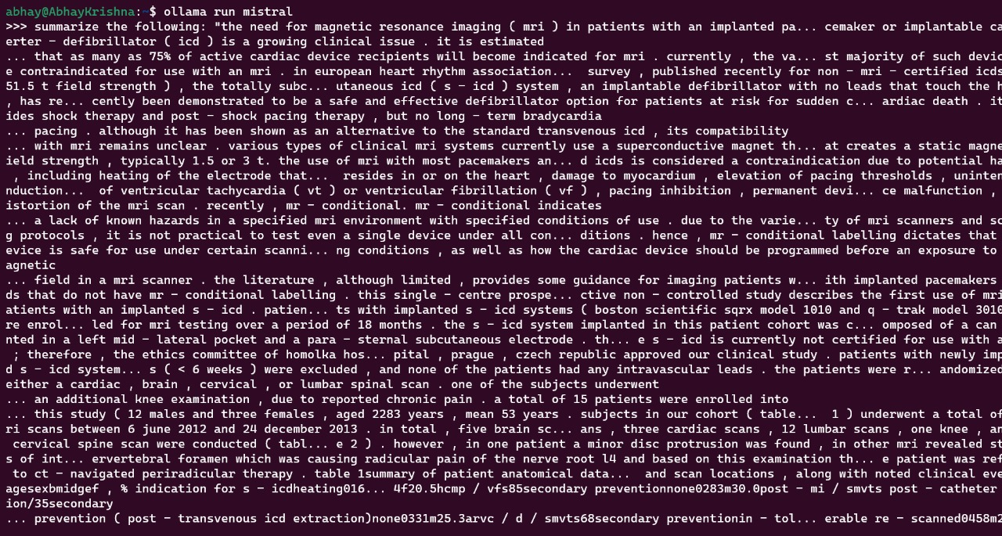
Trying to run mistral locally using ollama:

Slide 18
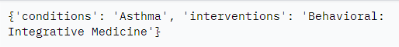
Result and validation:
Predicted result:
Result:

Slide 19
Further Plans
Find Appropriate resources for Fine-tuning LLM.
Apply RLHF on Fine-Tuned LLM.
Find a method to use RLAIF.
Compare the accuracy of the model using RLAIF alone, RLHF alone, both RLAIF and RLHF.

